Slide 1
Crime
How Police Funding and Law Enforcement impact Crime level

Slide 2
Facts and figures
In 2022, the violent crime rate was 380.7 per 100,000 people ~ > 1 millions violent offenses.
6.2 murder per 100k people ~ 19,196 death (murdered).
~ 500 billions cost of gun violent

Slide 3
Research Question
To what extent can the adoption of right-to-carry laws, along with other social and economic factors, predict changes in violent crime rates over a 10-year period?
How can changes in the prevalence of adolescent substance use disorders be used to predict future delinquency rates, while considering other demographic Factor?

Slide 4
Prior Works (1/4)
Source | Research question | Predictors | Statistical Analysis | Findings
Donohue et al (2019) | E adoption of RTC laws affect the overall rate in violent crimes | Right-to-carry law incarceration rate Police staffing Poverty rate Unemployment rate Per capita ethanol consumption from beer Percentage of state population living in metropolitan statistical areas (MSA) Real per capita personal income Real per capita income maintenance Real per capita retirement payments Real per capita unemployment insurance payments Population density Lagged violent or property arrest rate State population | Time series multilevel modeling was used | The results from the study shows that the adoption of RTC laws raises overall violent crimes in the 10 years after the laws are adopted.
Grucza RA, et al. (2018) | Declines in prevalence of adolescent substance use disorders and delinquent behaviors in the USA: a unitary trend? | Gender Age Race Population density Year Poverty rate | Multivariate regression analysis was used. | The results show that the reduction of substance use disorder SUD by 49% among 12 to 17-year-olds significantly reduced delinquent behaviors by 34%.

Slide 5
Prior Works (2/4)
Source | Research question | Predictors | Statistical Analysis | Findings
Schreck, et al.(2009) | Whether and why some crime types predominate in a given neighborhood over other types? | Immigration concentration Concentrated disadvantage Residential stability Neighborhood / network tie | 2 step methods: Multi-level regression: level 2 is neighborhood; violent and non-violent crime are separate dependent variable Spacial regression model for each neighborhood crime profile, with neighborhood structure predictors and social ties are IVs | Violent and non-violent crime are correlated, high violent crime neighborhoods tend to have high non-violent crime too Stronger neighborhood ties are associated with lower crime crate Greater concentrated disadvantage and residential mobility result in noticeable differential violent types.
Abrahamse, A. F., et al (1991). | The experiment design to evaluate impact of repeat offender program on conviction rate, severity and sentence length | Candidate background Current activity Substance abuse Probation failure Felony Conviction Past informant activity | Experiment designed to compare the Experiment group and the Control group. Comparison methods: Falloff (% all cases) Percentage passed on (% of passed on cases) Average charge at different proceeding stages Charge severity | With falloff: arrest, prosecuted, convicted rate slight increase while imprison rate increases 12% and long sentence increases 16% With passed on measurement: not much different in arrested, prosecuted, convicted rate while imprison rate increases 11% Charge severity of ROP group is significantly higher than Control group at all proceeding stages Actual sentence of ROP offenders are 1/3 longer than the controls. Prior records attribute 40% to conviction sentence for ROP group compared to 24% for Control group

Slide 6
Prior Works (3/4)
Source | Research question | Predictors | Statistical Analysis | Findings
Rafael Di Tella and Ernesto Schargrodsky 2004 | Does an increase in police officer deployment lead to deterrence of criminal activities in the short run, specifically in the context of New York City?" | Police Strength Jail Ratio Arrest Ratio Index Crime Rate Individual-Level Variables like age, male, black, education etc | Model involves multilevel regression techniques, specifically random intercept models, to assess the impact of various predictors, including police strength, jail ratio, arrest ratio, and individual-level characteristics, on perceptions of arrest likelihood for different crime types | the findings suggest that neither police strength nor actual arrest rates had a significant positive impact on perceptions of arrest likelihood for different crime types. Additionally, the study highlights the complex interplay of individual-level and contextual factors in shaping perceptions of arrest risk, challenging traditional interpretations of the relationship between policing, arrest rates, and perceived deterrence of crime.
John R. Lott Jr. and David B 1997 | Do right-to-carry (RTC) concealed handgun laws have an impact on crime rates, specifically, do these laws deter crime or influence crime rates in any significant manner? | Concealed Handgun Laws Arrest Rates Conviction Rates Mean Prison Sentence Length Demographic Variables like Age, sex , Race etc Waiting Periods State-Level Control Variables | the researchers used multiple regression techniques, including OLS and Tobit regression, to analyze the effects of concealed handgun laws on various outcomes while controlling for other factors | while concealed handgun laws are associated with reductions in some types of crime, they also coincide with increases in others. Additionally, the impact of concealed handgun laws varies depending on factors such as population size and demographic characteristics

Slide 7
Prior Works (4/4)
Source | Research question | Predictors | Statistical Analysis | Findings
Nagin, D. S. (1998). | The research reviewed and outlined future opportunities to address the difficulties in assessing the effectiveness of policies for deterring crime | Time factors of effects Sanction risks perceptions and crime behaviors Relationship of crime rate, sanction level and policy Sanction process Severity of punishment | the study utilized VAR (Vector Autoregression) models to explore the interconnectedness among multiple time series variables, thereby providing insights into the dynamic relationships between these variables over time. | Applying several research methods: scenario-based, panel-based … , the author concluded: Law enforcement exerts deterrent effects on crime level, e.g. police and prison population on crime rate. There are limitation in making confident predictions, because of: - The perceptions and response to policies - Time factors of policies effectiveness - Relationship of sanction risk and crime behaviors - Process of sanction generation.
David McDowall: Criminology Volume: 40 (2002) | Tests of Nonlinear Dynamics in U.S. Homicide Time Series, and Their Implications | Community Characteristics: Factors such as socioeconomic status, neighborhood cohesion, availability of resources Characteristics:demographic factors educational attainment, employment status, substance use, mental health status, history of trauma or victimization, and involvement in risky behaviors. Family Dynamics: Variables related to family structure, parenting practices, family violence | the researchers used multiple regression techniques, including OLS and GARCH models | The study likely finds that community-based interventions, empowerment initiatives, policy changes, and addressing social factors are crucial in preventing violence and reducing injuries. It emphasizes the need for interdisciplinary approaches to tackle the complex issues surrounding violence effectively.

Slide 8



Predictor Variables

Slide 9

Demographics
* Age | ↑ | Younger populations may be associated with higher crime rates.
* Race/Ethnicity | Uncertain | Relationships between race/ethnicity and crime are complex and require careful analysis to avoid bias.
* Gender | ↑ (Male) | Males are typically overrepresented in crime statistics.

Slide 10
Socioeconomic Factors
* Poverty Rate | ↑ | Poverty can be a risk factor for crime due to limited opportunities.
* Unemployment Rate | ↑ | Unemployment can lead to frustration and lack of opportunities, potentially increasing crime.
* Education Level | ↓ | Higher education can provide positive alternatives to crime.

Slide 11
Law Enforcement
* Police Funding | ↓ | More funding can strengthen law enforcement and deter crime.
* Incarceration Rate | Uncertain | High incarceration rates can have unintended consequences and might not effectively reduce crime.
* Proactive Policing Strategies (e.g., ROP) | ↓ | Proactive policing can deter crime by increasing police presence.

Slide 12
Legal Factors
* Right-to-Carry Law (Yes/No) | Uncertain | The impact of right-to-carry laws on crime is a complex issue with ongoing research.
* Strictness of Gun Control Laws | ↓ | Stricter gun control laws may limit access to firearms and reduce gun-related crimes.

Slide 13
Environmental Factors
* Population Density | Uncertain | Densely populated areas can have both higher crime opportunities and stronger police presence.
* Urbanization | ↑ | Urban areas may have higher crime rates due to anonymity and social disorganization.

Slide 14
Other Factors
* Lagged Violent Crime Rate | ↑ | Past crime rates are strong predictors of future crime.
* Substance Use Disorder Rate | ↑ | Substance abuse can be linked to criminal activity.

Slide 15
Data Source
Source | Collection Process | Update Frequency | Link to Data
FBI |  | Annually | https://ucr.fbi.gov/crime-in-the-u.s/
State Firearm Laws | By Michael Siegel, MD, MPH Boston University School of Public Health funded by the Robert Wood Johnson Foundation Evidence for Action Program & the National Institute of Justice. | The database has recently been updated through 2020. | https://mail.statefirearmlaws.org/national-data
Department of Justice | BJS collects law enforcement employment data through its periodic Census of State and Local Law Enforcement Agencies (CSLLEA) | Annually | https://bjs.ojp.gov/content/pub/pdf/nsleed.pdf
Census.gov | Population by state per year Educational attainment by state Poverty levels by state | Annually | https://data.census.gov/table?t=Education&g=010XX00US,$0400000&y=2012

Slide 16
Data Collection
Crime level will be collected at State level, yearly for 10 year from 2012 to 2022. Therefore, there will be 500 data points. We will focus on felony / violent crimes such as murder, human trafficking ...
Collect data for State police programs from FBI reports. The data will be categorized, mapped and attributed to State.
Gun enforcement laws are collected from State Firearm Laws
Demographic data like: population, education attainment, poverty rate at state level for 10 years from 2012 to 2022 are collected from Census

Slide 17
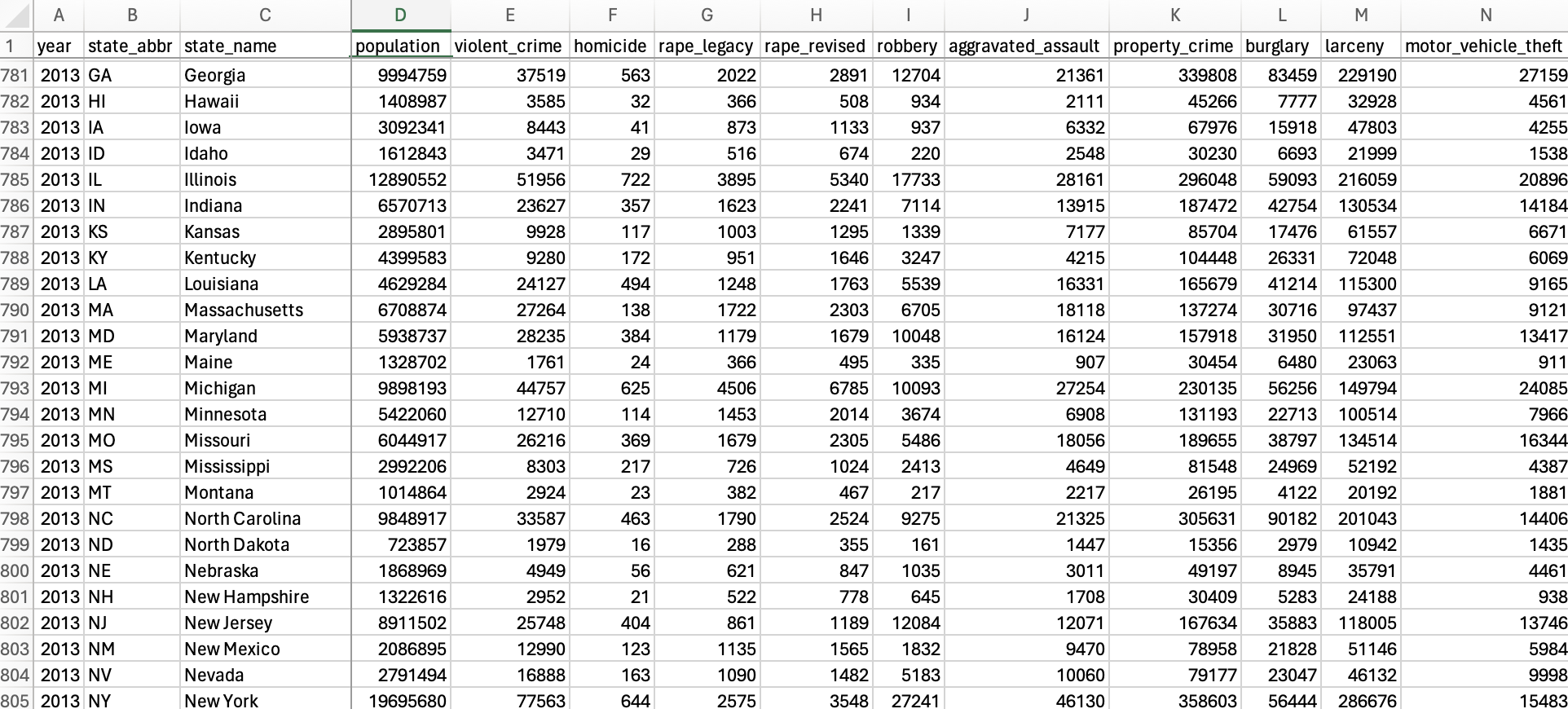
Data Collection – Crime Rate
Crime level will be collected at State level, yearly for 10 year from 2012 to 2022. Therefore, there will be 500 data points. We will focus on felony / violent crimes such as murder, human trafficking ...
Data range from 1979 to 2022

Slide 18
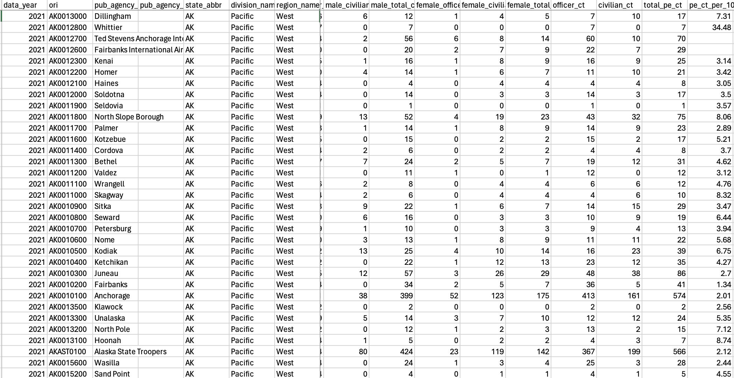
Data Collection – Police force
Data is collected at agency level, by year.
Need to aggregate to state level.
May factor in officers’ gender to analyze its impact on crime rate
Data range from 1960 to 2022

Slide 19
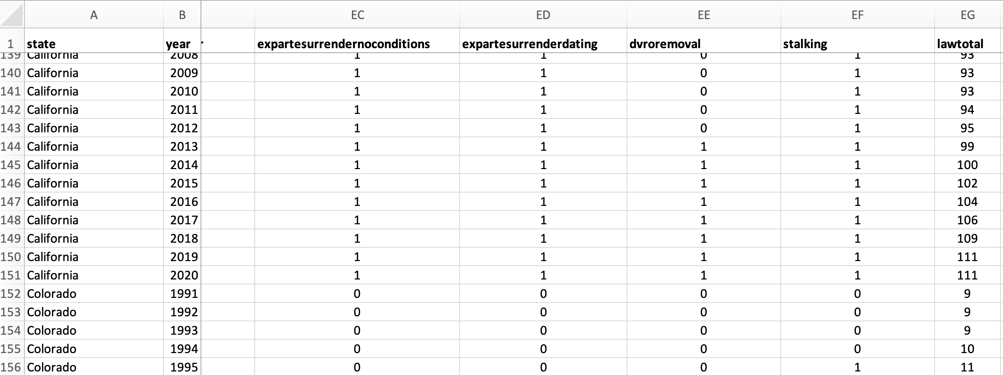
Data Collection – Gun Law
Data is collected at State level, by year with granular level at legal terms.
Will need to aggregate features to enforcement groups like seller responsibilities, open carry …
Data range from 1991 to 2020

Slide 20
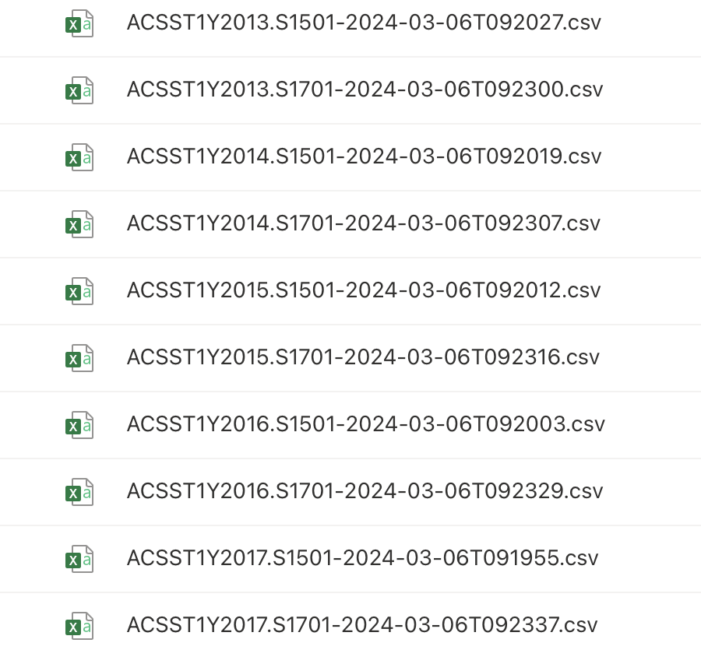
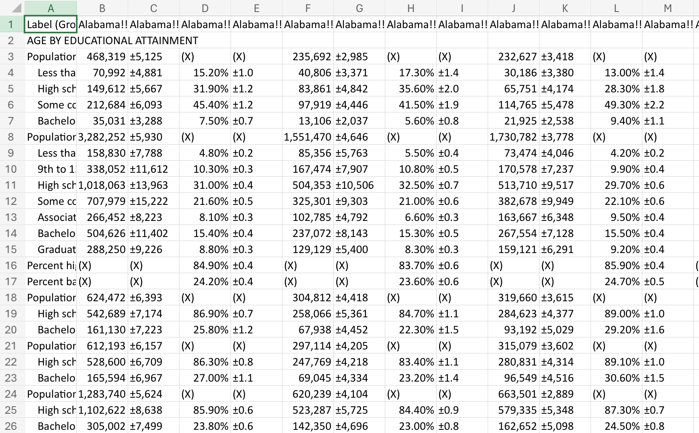
Data Collection – Demographic
Data is collected at State level, by year with very granular level.
Data is not presented processable format

Slide 21
Data Cleansing
Cleaning data and ensure the source data match to State level and the same yearly time-scale from 2012 to 2020 (as the latest we can get from Gun Law)
Crime rate
Trim data from 2012 to 2020
Gun Law
Trim data from 2012 to 2020
Demographic
Re-format data sources (by year)
Police force
Group agency level to state level
Merge data sources to single file
Trim data from 2012 to 2020

Slide 22
Feature Engineering
Identify Predictors
Add Lag of Previous Crime Rates
Aggregate Features
Add Events: New Law Issues, Covid, BLM ...

Slide 23
Data visualization

Slide 24
Modelling
Model
Predictors
GLM
Education
Male Police
# Total Gun Law
Events (binary each)
Time Series – Lag effect
Population
Female Police
Availability (binary) / strictness (weighted terms) of select law
DV: Violent Crime + Aggrava
Poverty

Slide 25
Result

Slide 26
Interpretation & recommendation

Slide 27
conclusion

Slide 28
Reference for Prior works
1 | Donohue, John J., Abhay Aneja, and Kyle D. Weber. “Right‐to‐Carry Laws and Violent Crime: A Comprehensive Assessment Using Panel Data and a State‐Level Synthetic Control Analysis.” Journal of empirical legal studies 16.2 (2019): 198–247. Web.
2 | Grucza RA, Krueger RF, Agrawal A, et al. Declines in prevalence of adolescent substance use disorders and delinquent behaviors in the USA: a unitary trend? Psychological Medicine. 2018;48(9):1494-1503. doi:10.1017/S0033291717002999
3 | Schreck, Christopher J., McGloin, Jean Marie and Kirk, David S.(2009)'On the Origins of the Violent Neighborhood: A Study of the Nature and Predictors of Crime-Type Differentiation across Chicago Neighborhoods',Justice Quarterly,26:4,771 — 794
4 | APA 7th ed. Abrahamse, A. F., Ebener, P. A., Greenwood, P. W., & Fitzgerald, Nora. (1991). An experimental evaluation of the phoenix repeat offender program. Justice Quarterly, 8(2), 141-168.
5 | Gary Kleck and J. C. Barnes "Do More Police Lead to More Crime Deterrence?" Crime & Delinquency 2014 60: 716 originally published online 18 October 2010
6 | David B. Mustard and John Lott "Crime, Deterrence, and Right-to-Carry Concealed Handguns" 1996
7 | Nagin, D. S. (1998). Criminal Deterrence Research at the Outset of the Twenty-First Century. Crime and Justice: Review of Research, 23, 1-42.
8 | David McDowall: Criminology Volume: 40 Issue: 3 Dated: August 2002 Pages: 711-736 (2002).

